Slide 1


SOLAR POWERED IoT BASED ROBOT FOR RAILWAY TRACK INVESTIGATION WITH AI ASSISTANCE
K.RAMAKRISHNAN COLLEGE OF ENGINEERING
(Autonomous)
Accredited by NAAC with - 'A' Grade, NBA Accreditation of EEE
DEPARTMENT OF ELECTRICAL AND ELECTRONICS ENGINEERING
BATCH NO : 06
GUIDED BY
Mr. A. Prabhu, M.E.,(Ph.D)
Assistant Professor
Electrical and Electronics Engineering
K.Ramakrishnan College of Engineering,
(Autonomous)
Samayapuram, Tiruchirappalli – 621 112

Slide 2
SOLAR POWERED IoT BASED ROBOT FOR RAILWAY TRACK INVESTIGATION WITH AI ASSISTANCE
PRESENTED BY
GOPIKA S - 8115U22EE014
SARSIKA SRI K - 8115U22EE041
SURIYADHARSHINI S P - 8115U22EE049
VENNILA SRI S - 8115U22EE055
Department of Electrical and Electronics Engineering
Fourth Year / 8th Semester
K.RAMAKRISHNAN COLLEGE OF ENGINEERING
(Autonomous)

Slide 3
ABSTRACT
This project presents a solar-powered AI and IoT-based railway safety robot for real-time monitoring.
ESP32 camera is used for visual detection of obstacles on railway tracks.
IR and ultrasonic sensors provide accurate and reliable obstacle detection.
ESP8266 enables IoT communication for real-time alerts and remote monitoring.
Motor drivers and motors allow autonomous movement for continuous inspection.
Solar panel and battery ensure eco-friendly and uninterrupted operation.
Overall, the system offers a smart, reliable, and future-ready solution for accident-free railway safety.

Slide 4
OBJECTIVE
To design a smart railway safety robot for real-time obstacle detection on tracks.
To implement AI-based detection using ESP32 camera for improved accuracy.
To enable IoT communication using ESP8266 for instant alerts and monitoring.
To develop an autonomous system using sensors and motor drivers for track inspection.
To utilize solar energy for eco-friendly and continuous operation.
To integrate multiple sensors (IR, ultrasonic, GPS) for reliable performance.
To create a safe, efficient, and scalable solution for modern railway systems.

Slide 5
LITERATURE SURVEY
S.No | Year of Publication | Title | Author | Focus on Paper | Parameters Analyzed
1 | 2025 | Sensor-Based Railway Track Monitoring System | S. I. Salim | Real-time railway track monitoring using basic sensors | Vibration, Real-time sensing
2 | 2024 | Wireless Railway Track Monitoring System | M. Sharma | IoT –Based Wireless monitoring of track condition | Sensor data, Communication

Slide 6
LITERATURE SURVEY(CONT)
S.No | Year of Publication | Title | Author | Focus on Paper | Parameters Analyzed
3 | 2023 | IoT-Based Railway Track Monitoring System | S. Gupta | Crack detection using sensor modules and IoT | Vibration, Stress, Displacement
4 | 2022 | Obstacle Detection using IoT Sensors | K. A. Mohamad | Detection of obstacles using distance sensors | Distance sensing, Data transmission

Slide 7
PROBLEM FORMULATION
Railway accidents occur due to late detection of obstacles and track faults, causing serious safety risks.
Existing systems relay on manual monitoring, which is affected by human error, fatigue, and limited attention.
Lack of real-time monitoring and instant alert systems leads to delayed emergency response.
Poor visibility in fog, rain, and night conditions reduces the effectiveness of traditional safety methods.
An intelligent, automated, solar-powered IoT system is required for continuous monitoring and accident prevention

Slide 8
EXISTING SYSTEM
Railway tracks are monitored mainly by manual inspection and loco pilots, which limits continuous safety.
Traditional signaling systems control trains but cannot detect real-time obstacles or track faults.
The system depends on human decisions, which may lead to errors and delayed response.
There is no proper real-time alert system with location tracking, especially in remote areas.
Overall, the system lacks automation and real-time monitoring, creating the need for a smart safety solution.

Slide 9
EXISTING SYSTEM LIMITATIONS
Depends on manual inspection by workers and loco pilots, leading to lack of continuous monitoring.
Cannot detect real-time obstacles or track faults, reducing overall safety effectiveness.
Heavy reliance on human decisions may lead to errors and missed issues.
No proper real-time alert system with location tracking, especially in remote areas.
Delayed response during critical situations increases the risk of railway accidents.
Lacks automation and smart monitoring features, reducing efficiency and proactive safety measures.

Slide 10
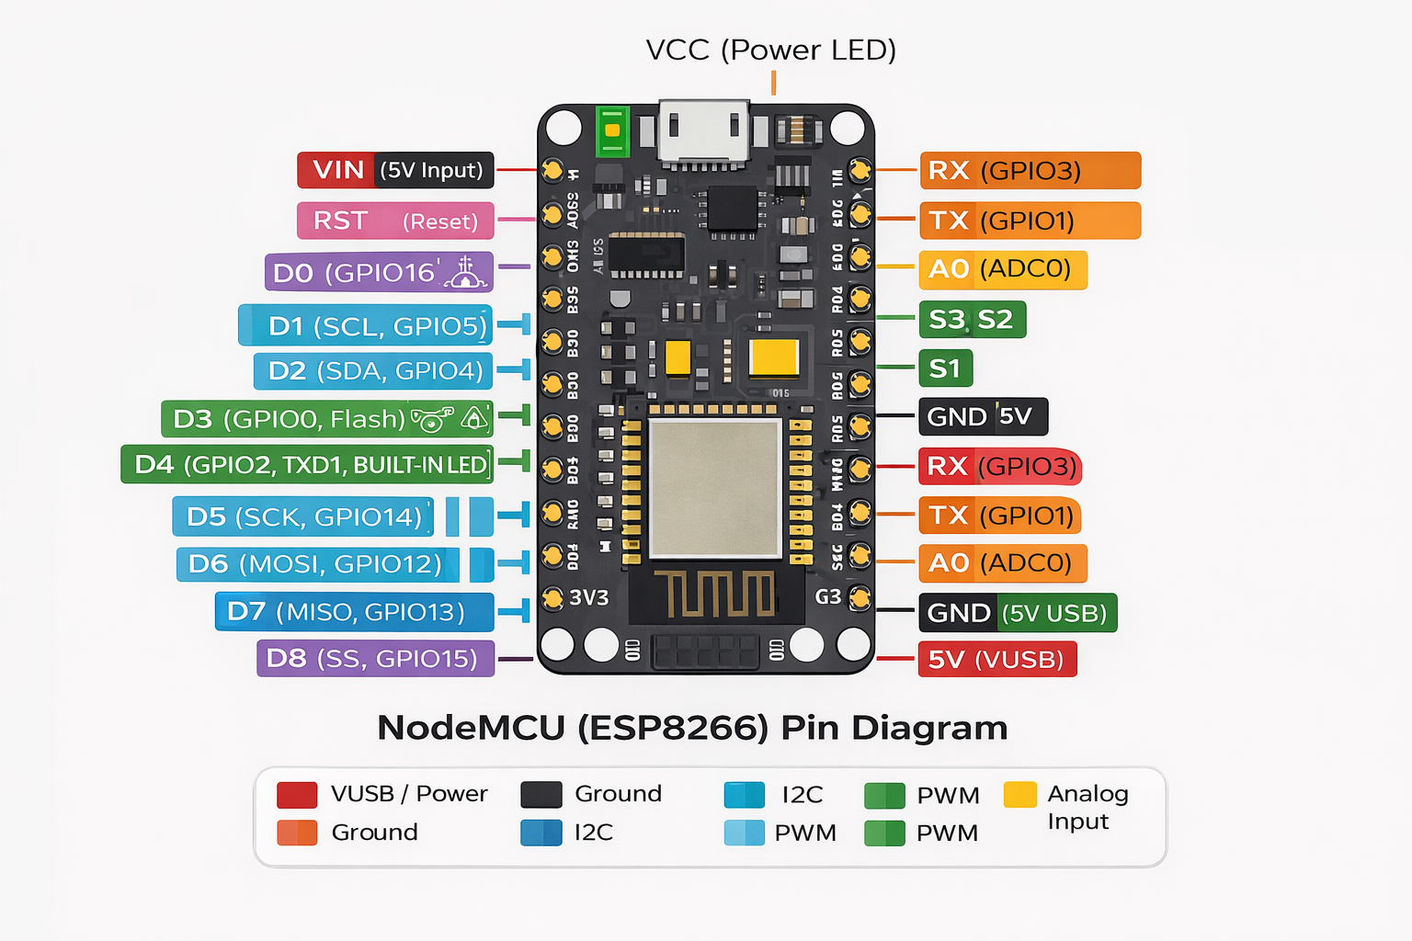
PIN DIAGRAM

Slide 11
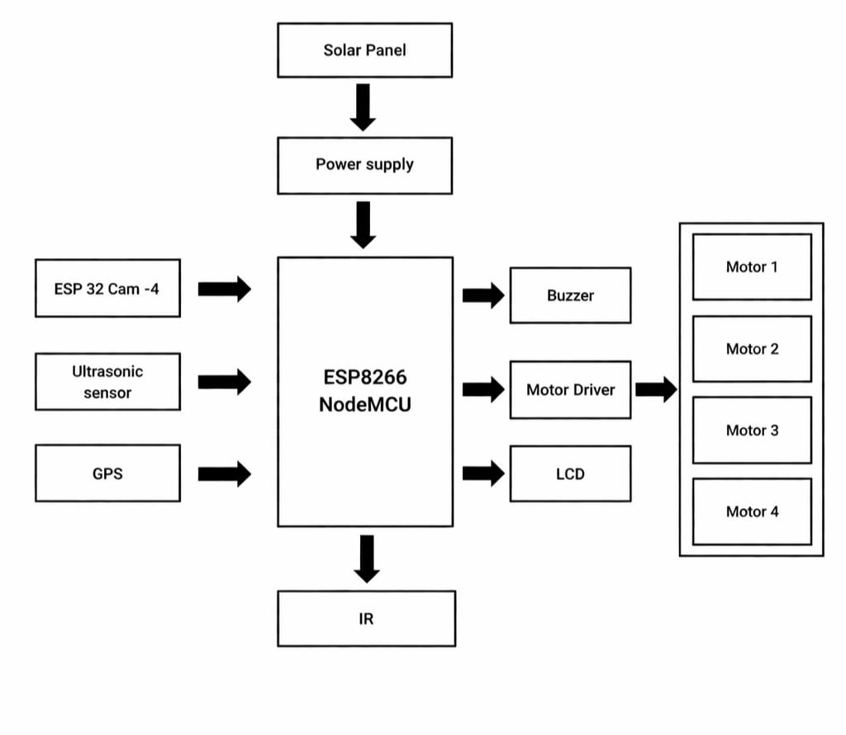
BLOCK DIAGRAM

Slide 12
PROPOSED SYSTEM
Controller Unit: The ESP8266 Node-MCU serves as the central controller, efficiently processing sensor data and coordinating all system operations.
Sensing Unit: Ultrasonic and IR sensors enable accurate real-time detection of obstacles and track conditions to enhance safety.
Vision System: The ESP32-CAM provides AI-based visual monitoring, improving detection reliability and situational awareness.
Tracking & Communication: The GPS module ensures precise location tracking, enabling quick alerts and effective emergency response.
Power Management: The solar panel with battery delivers continuous, energy-efficient operation, making the system reliable in remote areas.

Slide 13
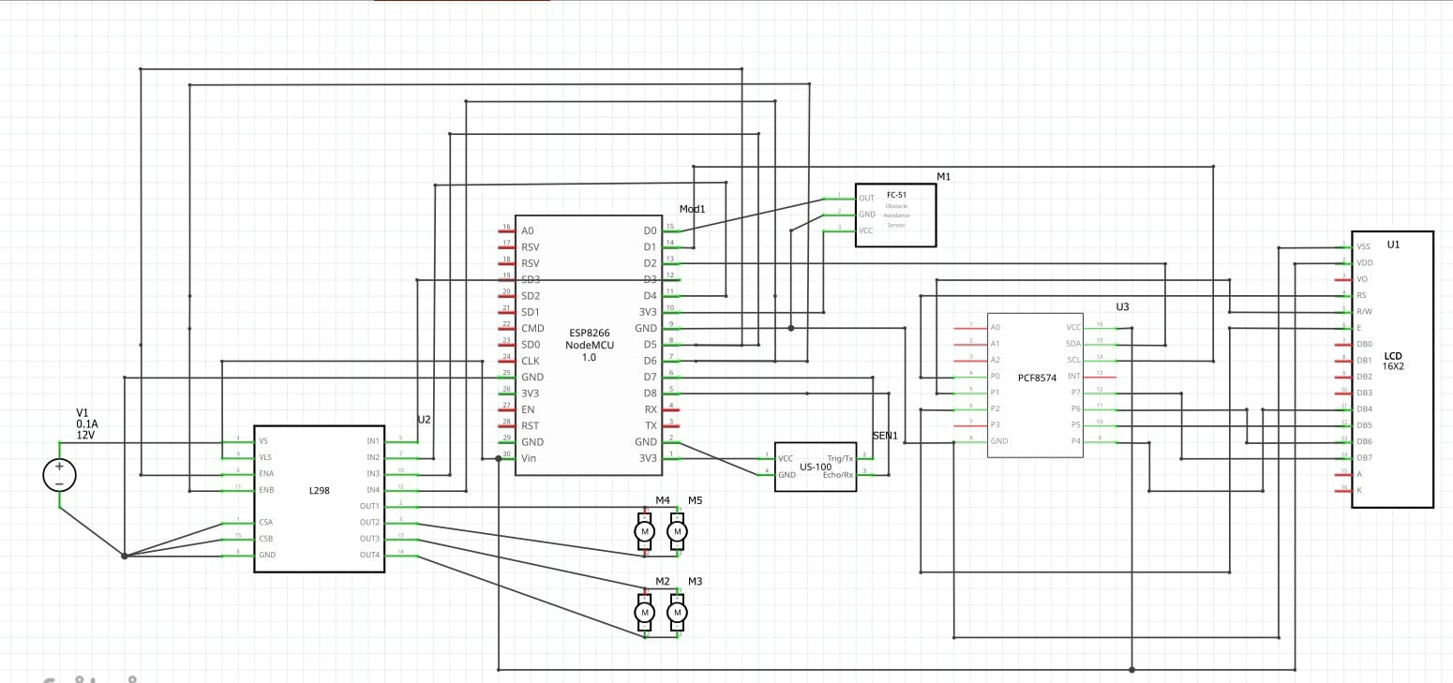
CIRCUIT DIAGRAM

Slide 14
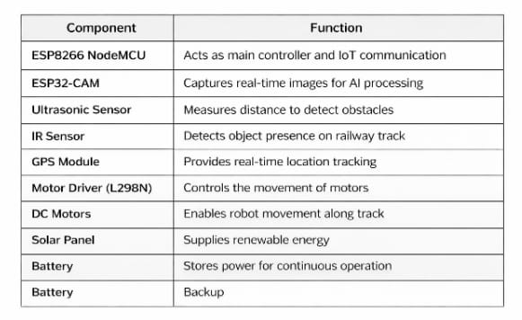
COMPONENTS USED

Slide 15
PROPOSED SYSTEM WORKING
The system is powered by a solar panel with battery backup, ensuring uninterrupted operation even in remote railway areas.
The ESP8266 microcontroller acts as the central control unit, managing sensor inputs and communication.
The ESP32 camera module continuously captures real-time images of the railway track.
IR and ultrasonic sensors detect obstacles based on object presence and distance measurement.
The collected data from sensors and camera is processed together for accurate obstacle identification.
AI algorithms analyze the captured data to improve detection accuracy and reduce false signals.
This stage forms the intelligent foundation of the system by ensuring precise and reliable obstacle detection.

Slide 16
PROPOSED SYSTEM WORKING
After detection, the system uses AI-based decision-making to confirm and classify obstacles.
The motor driver and motors enable the robot to move autonomously along the railway track.
When an obstacle is detected, the system immediately stops and initiates safety actions.
The GPS module provides exact location details of the detected obstacle.
Through IoT (ESP8266), real-time alerts are sent to railway authorities or users.
The system ensures continuous monitoring, quick response, and reduced human dependency.
This system provides a smart, autonomous, and life-saving solution that significantly enhances railway safety and efficiency.

Slide 17
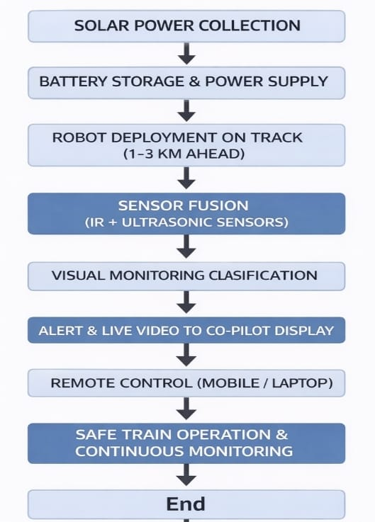
SYSTEM FLOWCHART

Slide 18
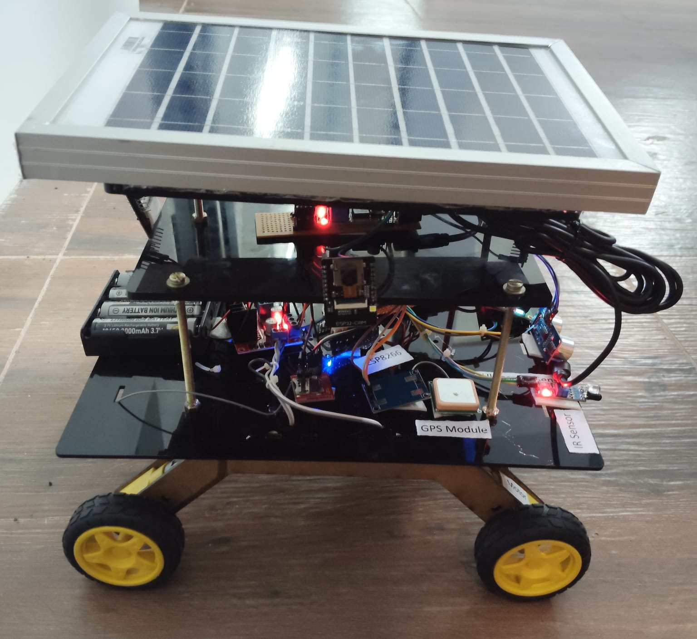
HARDWARE PROTOTYPE

Slide 19
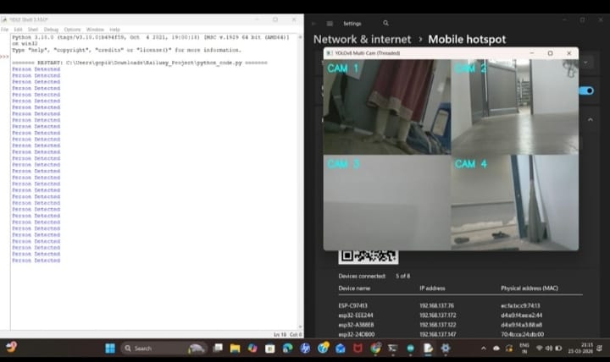
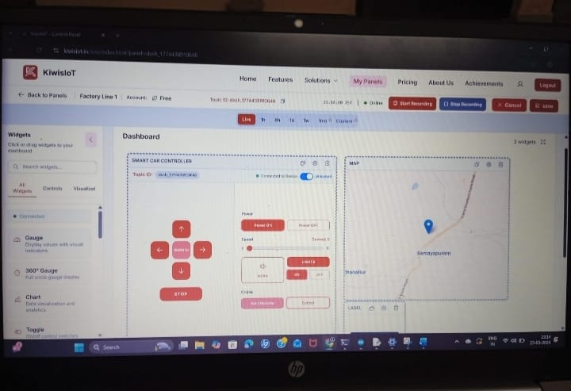
RESULTS AND OUTPUT

Slide 20
ADVANTAGES
Real-time obstacle detection improves safety.
Continuous monitoring reduces human effort.
Solar power ensures eco-friendly operation.
IoT enables instant alerts and remote control.
AI improves accuracy and decision making.
Works effectively in remote areas.
Reduces accident risk through early detection

Slide 21
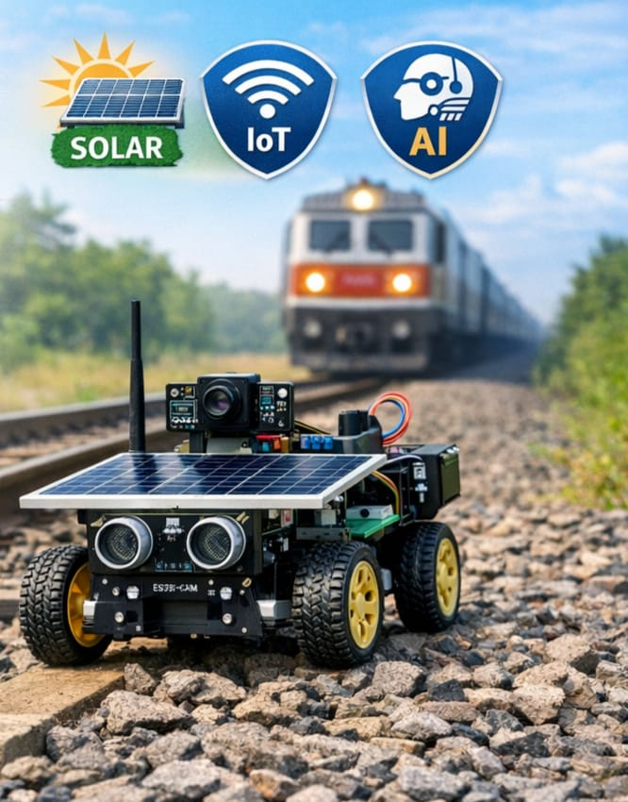
APPLICATIONS
Railway track safety monitoring ensures safe and continuous inspection.
Real-time obstacle detection identifies obstacles quickly using sensors and AI.
Autonomous track inspection performs automatic monitoring in remote areas.
IoT-based remote monitoring enables real-time tracking and control.
Immediate alerts with live tracking.
.

Slide 22
FUTURE SCOPE
Advanced AI: Improve ESP32 camera for faster and more accurate obstacle detection.
Expanded IoT Monitoring: Enable cloud-based real-time monitoring using ESP8266.
Autonomous Navigation: Develop fully self-patrolling robot using sensors and motor drivers.
Optimized Solar: Enhance battery and solar system for continuous operation.
Multi-Sensor Integration: Add more IR, ultrasonic, and GPS sensors for better safety.
Data Analytics: Analyze IoT data to predict railway hazards in advance.
Centralized Control: Connect system with railway control centers for quick response.

Slide 23
CONCLUSION
The system ensures real-time obstacle detection using AI and IoT, improving railway safety significantly.
ESP32 camera, ESP8266, sensors, and motor drivers enable autonomous, intelligent track monitoring.
Solar-powered design ensures continuous, eco-friendly operation in remote areas.
Multi-sensor integration provides a scalable and reliable solution for nationwide railway safety.
Overall, the project is a smart, sustainable, and futuristic step towards accident-free railways.

Slide 24
REFERENCE
[1] M. Tandon, et al., “Obstacle Detection on Railway Track Using Ultrasonic Sensor,” International Journal of Research in Engineering and Applied Sciences (IJREAM), vol. 6, no. 4, pp. 45–49, 2020.
[2] A. A. Aziz, et al., “Train Obstacle Detection System Using Microcontroller,” Indonesian Journal of Electrical Engineering and Computer Science (IJEECS), vol. 21, no. 2, pp. 1123–1130, 2021.
[3] M. K. A. Mohamad, et al., “Obstacle Detection System for Railways using IoT Sensors,” Journal of Engineering and Applied Sciences, vol. 15, no. 7, pp. 2105–2110, 2020.
[4] IRJET Authors, “IoT Based Railway Monitoring System,” International Research Journal of Engineering and Technology (IRJET), vol. 7, no. 6, pp. 2395–0072, 2020.

Slide 25


